Slide 1
晶圓製造區人員進出管制規範
S100

Slide 2
晶圓製造區人員進出管制規範
目的(Purpose)
規範並管制潔淨區人員之進出動作﹐以減少污染源之攜入或產生影響潔淨區之潔淨度﹐進而影響產品之品質
Standardize and control FAB entering to reduce fiber sources, which affecting the quality of product.
適用時機 (When to use)
人員進出 FAB 潔淨區時,均受本規範限制。
Those who want to enter the Clean Room must comply with this O.I.

Slide 3
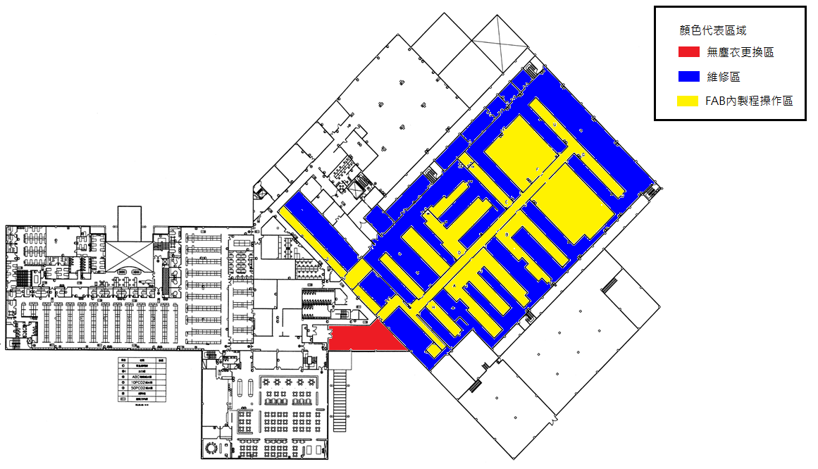
FAB內區域潔淨度劃分
進入 Air Shower 1 後屬於FAB區域
After entering Air Shower 1, it belongs to the FAB area
無塵衣更換區潔淨度<=Class1000
Class level of the cleanroom changing area <=Class1000
FAB內製程操作區潔淨度<=Class1
Class level of the area within the FAB<=Class1
維修區潔淨度<=Class1000
Class level of maintenance area <=Class1000

Slide 4
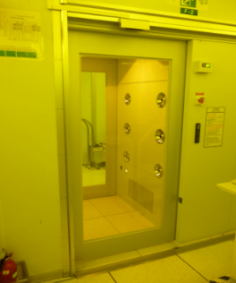
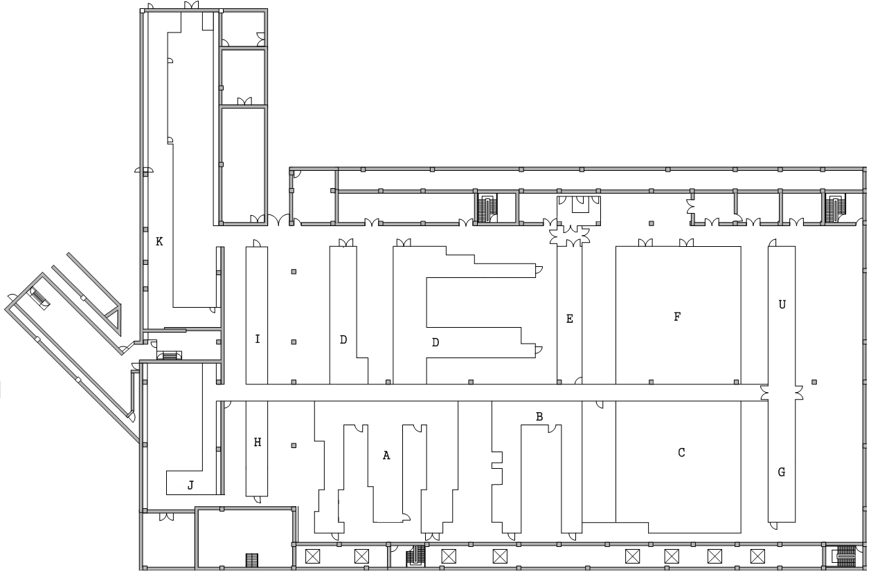
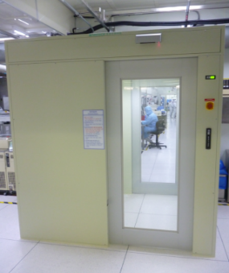
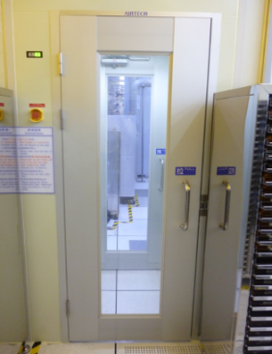
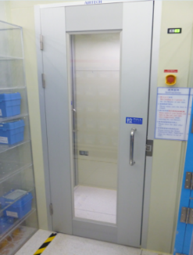
進入FAB製程操作區須從Air Shower進入
從維修區進到FAB製程操作區務必從 Air shower 進入(四座Air Shower位置如下圖)
It will be necessary that walk by air shower if you are from maintenance area back to process area.
F-T Air Shower
I-T Air Shower
I-T
F-T
E-T Air Shower
H-T Air Shower
H-T
E-T

Slide 5

無塵室Buffer區鐵捲門進出規範
A 門：一般區通往Buffer區的門 B 門：FAB維修區通往Buffer區的門
Door A: The door from the general area to the buffer area. Door B: The door from the FAB maintenance area to the buffer area.
A、B 門不可同時開啟
Doors A and B cannot be opened at the same time
由FAB到Buffer區只能開B門，A門不可打開
Only door B can be opened from FAB to Buffer area, door A cannot be opened.
由一般區到Buffer區作業時A門需打開，B門不可打開
When working from the general area to the Buffer area, door A must be opened, door B cannot be opened.

Slide 6
無塵室進出前規範
凡本公司同仁且隸屬 S000、TC00、S800 及經核准之常駐代理商，始可自由 進出潔淨區，但在潔淨區內需配掛潔淨區識別證。
Employees of the departments like S000, TC00, S800 and vender which already be approved can enter the fab by producing their Identity card.
非隸屬 1 項之本公司同仁，需至管制櫃台登錄，並換取潔淨區識別證，始可進入。
Customers, guests and non-approved venders must obtain a temporary identity card at entrance of the fab.
客戶、貴賓、來賓及非經核准之代理商，需由各負責部門派引導人員，填寫『來賓、外賓潔淨區進入申請單』，經核准後至管制櫃台登錄，換取潔淨區識別證始可進入，且由引導人員指導進入潔淨區流程及規範。
Customers, VIPs, guests and non-approved venders must be sign in "Customers, guests application form" to obtain fab ID card and led by the responsible members from the

Slide 7
進入無塵室規章 Clean Room Discipline
在FAB一律不可化妝、擦香水。
Makeup and perfumes are not allowed in FAB.
只能攜帶公司配發無照相功能手機進入無塵室。
Only can bring the company mobile phone without camera function into the clean room
進入更衣室前應更換 PAJAMAS、膠鞋。
To wear FAB pajamas and clean shoes before entering into clean room.
無塵室內嚴禁使用普通紙本及鉛筆，需使用無塵室專用紙筆。
Must use cleanroom-specific pen and paper which approved by the manufacturing department in FAB.
戴髮網時需將瀏海紮入。
All the hairs must cover by hair cap when wearing hair cap in FAB.
在FAB內不可將口罩拉離口鼻。
Can’t pull the facemask away from mouth.

Slide 8
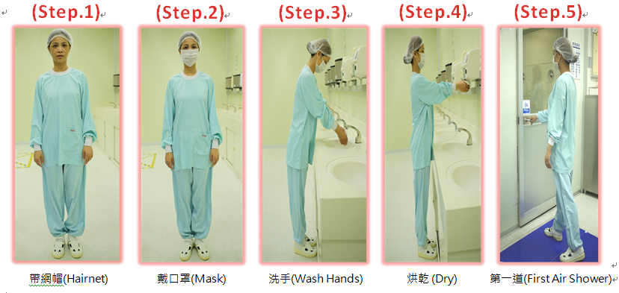
進入FAB 標準流程 SOP of FAB Coverall Dressing
進第一道Air Shower 步驟
First Air Shower SOP
注意：洗手完後手上不可有殘留水珠
Note: there should be no residual water drops on your hands after washing your hands

Slide 9
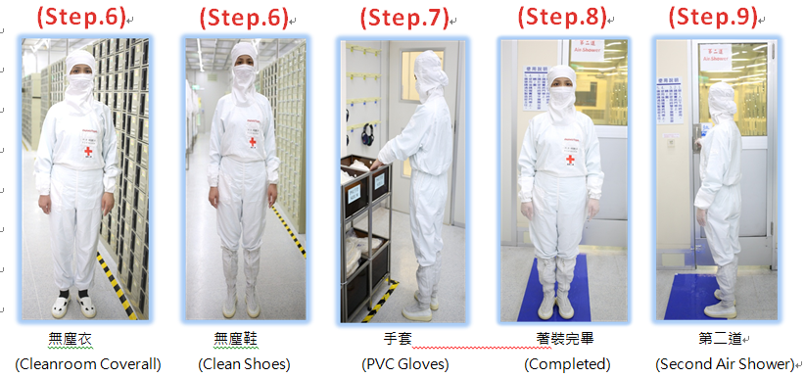
進入FAB 標準流程 SOP of FAB Coverall Dressing
進第二道Air Shower 步驟
Second Air Shower SOP

Slide 10
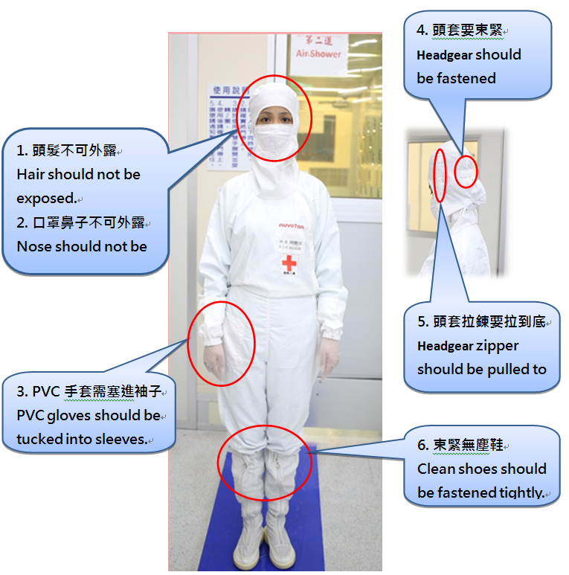
無塵衣穿著注意事項 Notice for FAB Coverall Dressing

Slide 11
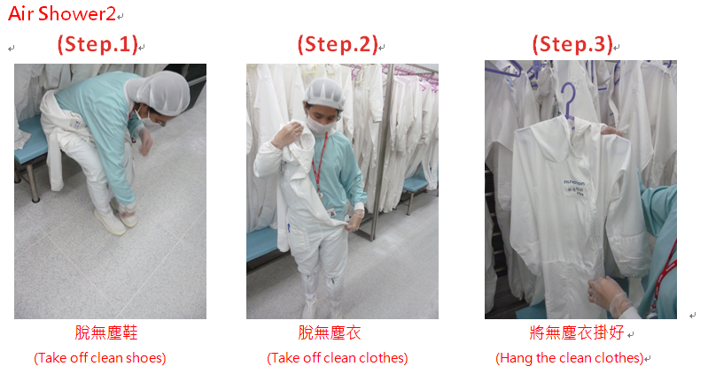
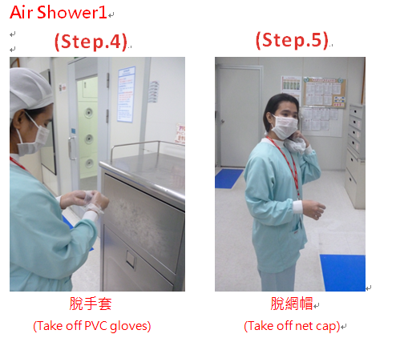
出FAB 標準流程 SOP of FAB Coverall Dressing
注意: 手套、網帽不能在無塵衣更換區先脫，必須等出到洗手台梳洗區才可脫
Note: Gloves and net caps cannot be taken off before entering grooming area
無塵衣更換區
Step 1~3
洗手台梳洗區
Step 4~5

Slide 12
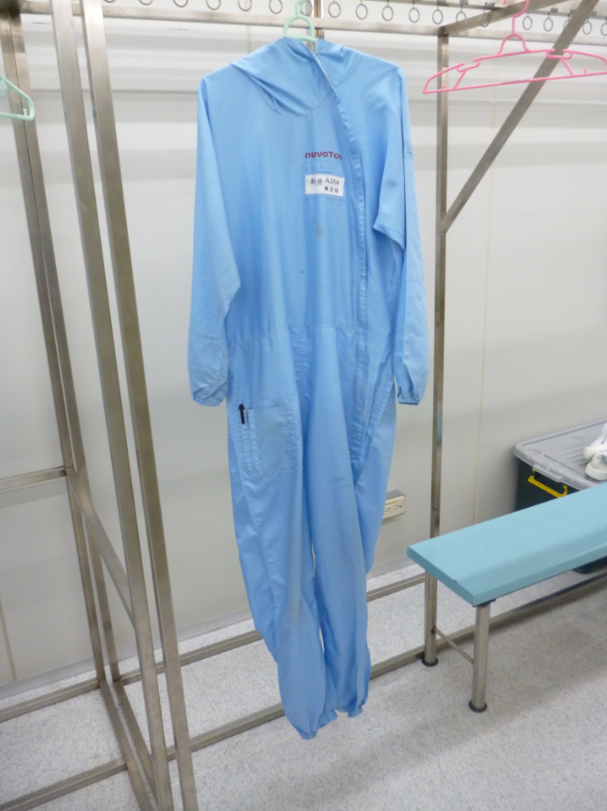
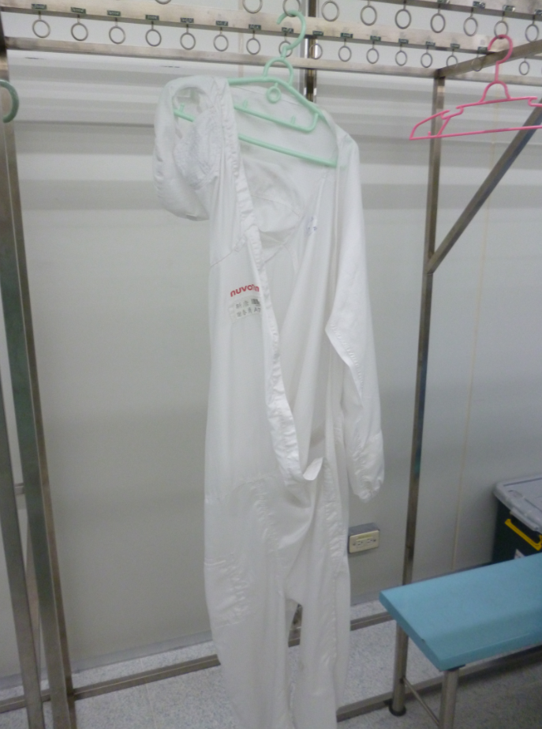
正確無塵衣吊掛方式 Hanging method of clean clothes
注意：無塵衣吊掛拉鍊須拉上掛正，避免衣服掉落
Note: The zipper of the Clean clothes must be closed and hung upright to prevent the clothes from falling
O正確吊掛方式
X錯誤吊掛方式

